Slide 1
Improving Safer Care Transitions to Reduce Readmissions Montgomery Count Palliative Care and End of Life Coalition Meeting
Janet Jones
September 19, 2023
This material was prepared by the IPRO QIN-QIO, a Quality Innovation Network-Quality Improvement Organization, under contract with the Centers for Medicare & Medicaid Services (CMS), an agency of the U.S. Department of Health and Human Services (HHS). Views expressed in this material do not necessarily reflect the official views or policy of CMS or HHS, and any reference to a specific product or entity herein does not constitute endorsement of that product or entity by CMS or HHS. Publication # 12SOW-IPRO-QIN-TA-A4-22-804

Slide 2
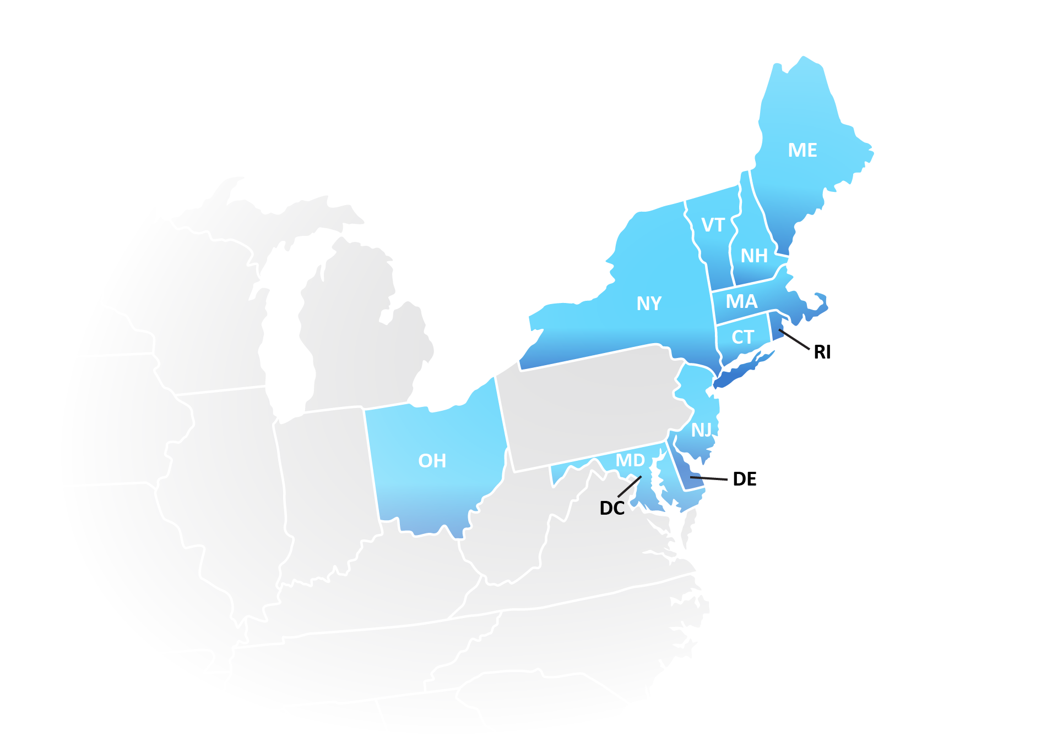
The IPRO QIN-QIO
Quality Innovation Network – Quality Improvement Organization
Federally funded, contract with CMS
12 regional QIN-QIOs across the country
20% of Medicare FFS beneficiaries
Notes:
IPRO: New York, New Jersey, and Ohio
Healthcentric Advisors: Connecticut, Maine, Massachusetts, New Hampshire, Rhode Island, and Vermont
Qlarant: Maryland, Delaware, and the District of Columbia

Slide 3
Purpose of QIN-QIO care transition reports
Illuminate opportunities at your hospital
Identify readmission patterns specific to your community
Guide intervention selection and focus
Track process and outcome data
Complement input from frontline staff, patients, community

Slide 4
Care Transitions Reports available
HHA Report coming soon!
State
Community
Provider
SNF – Newest Report

Slide 5
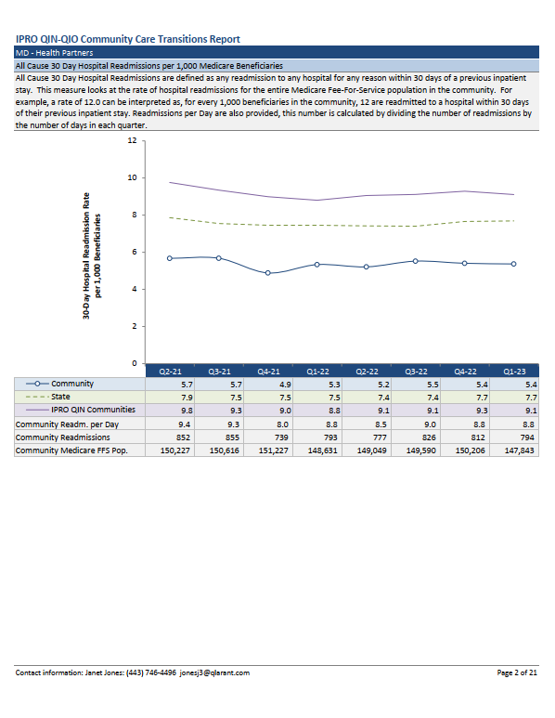
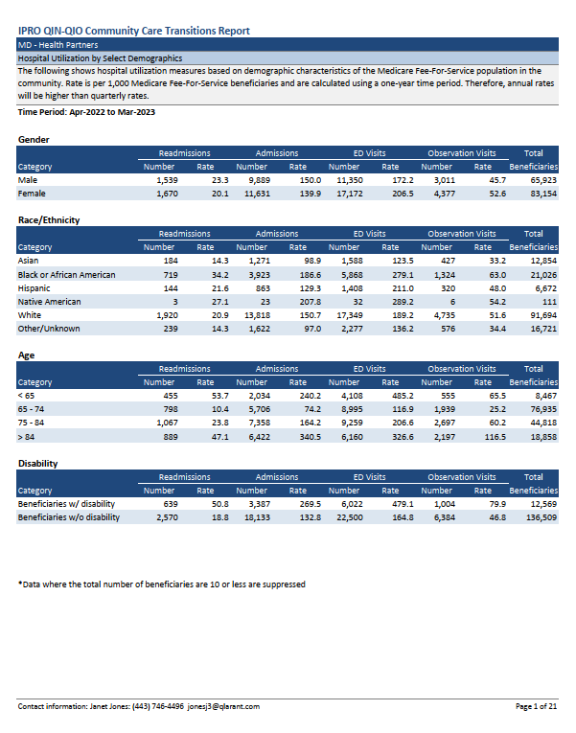
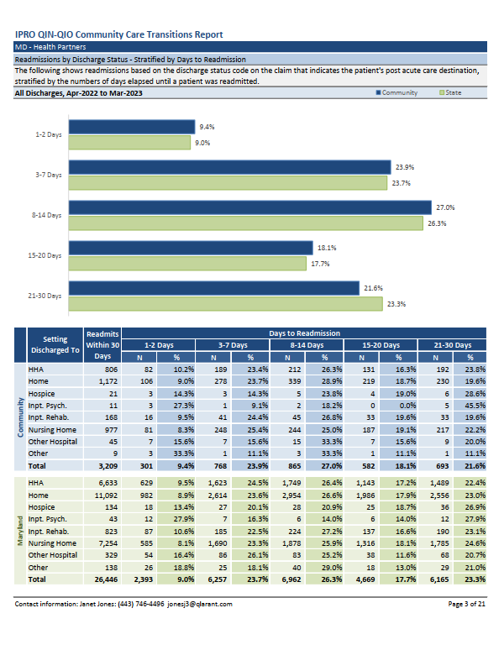
Community Report – Health Partners

Slide 6
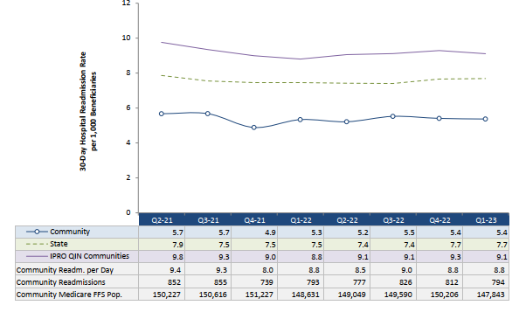
Community Data: all readmissions
Notes:
You can use this data to help you
Understand the big picture
Compare to state and regional
Trend over time
Track overall progress and impact of interventions

Slide 7
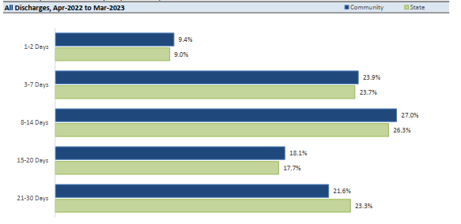
Community data: Post-acute care graph
Notes:
April 2022 – March 2023
Post- Acute Care Readmissions by d/c status – stratified by days to readmissions and shows readmissions based on the discharge status code on the claim that indicates the patient's post acute care destination, stratified by the numbers of days elapsed until a patient was readmitted.

Slide 8
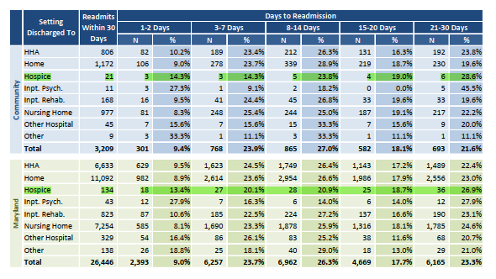
Community: Post-acute care by d/c Status
Notes:
April 2022 to March 2023
1st It doesn’t seem like a lot of readmits for the community for 1 year period but should there be any at all for hospice.
2nd point – when looking at 1 -2 days readmits , who should own that? Please don’t beat up on me if I get this wrong but could we question if the patient was stable enough when they were d/c to hospice or were the patient and family educated properly on hospice services and what to do. The other good thing here is that this could be further researched by looking at the hospital reports and seeing what the
3rd point – what’s happening at the 1 to 2 week period. At this point I would make the assumption that we would look more closely at the hospice facility to see what happened here and doing a little deeper dive.

Slide 9
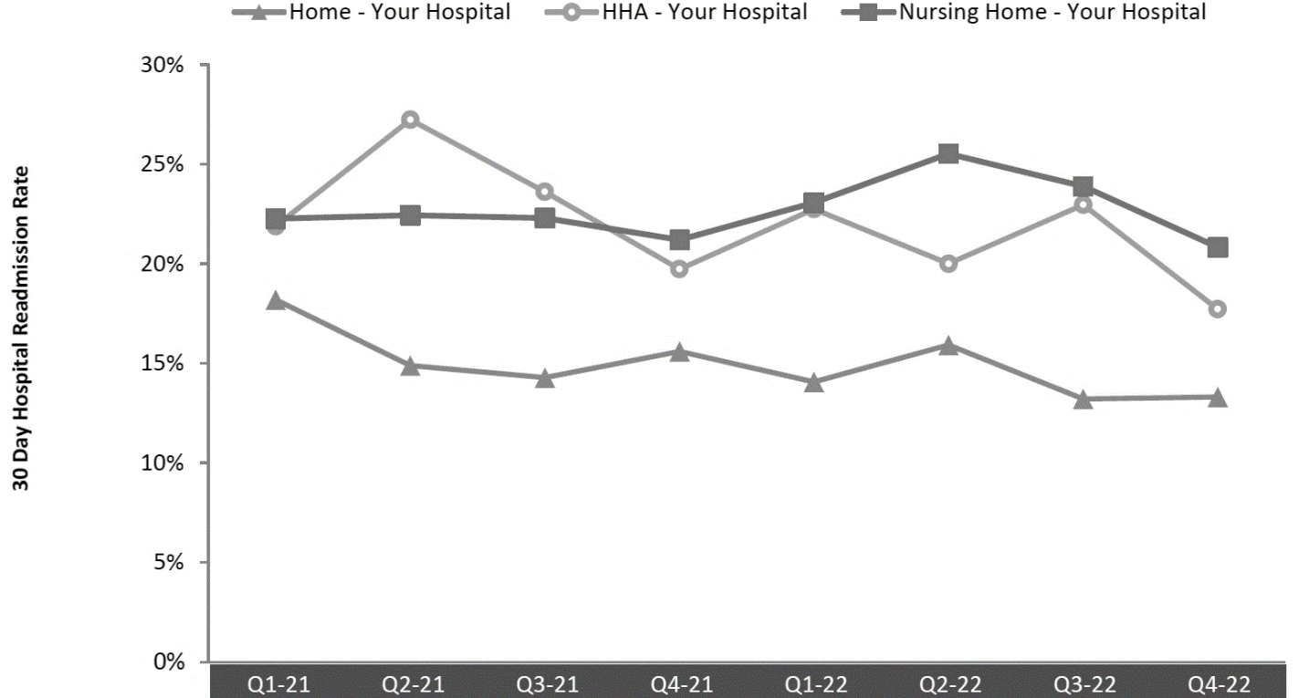
Hospital-level data: post-acute care
How to use these data
Compare rates among settings
Explore high rates from a particular setting
Engage community partners to improve transitions

Slide 10
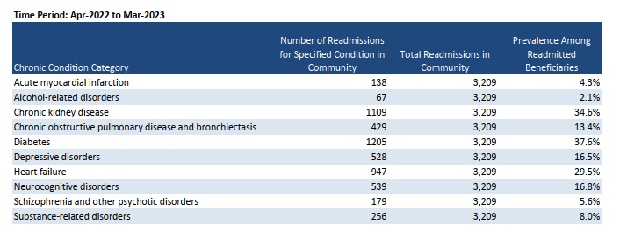
Community data: Co-morbid diagnoses
Notes:
This measure looks at which chronic conditions were most common among all the beneficiaries who were readmitted to the hospital within 30 days. These data do not show readmission rates; instead they look at how prevalent certain diagnoses are among readmitted patients. For example, if the prevalence of diabetes is about 36%, this would mean that a little more than a third of all beneficiaries who were readmitted had a diagnosis of diabetes. Chronic conditions were identified using any diagnosis code (principal or secondary) included on the inpatient hospital claim.
Include both primary and secondary diagnosis codes; a patient can have multiple chronic conditions
Where to direct your focus and on what types of patients. Working with other providers within the community and looking at your own data,
Possible interventions

Slide 11
Community Level: Co-morbid diagnoses
How to use these data
Identify over-represented diagnoses
Evaluate effects of diagnosis-directed interventions
Highlight impact of behavioral health and substance use

Slide 12
Community -level data: lots more good stuff
days to readmit
multi-visit hospital use
top 10 obs stay diagnoses
all cause 30-day readmits
readmits for select health conditions
all cause 30-day obs stays
readmits by discharge destination
top 10 readmit diagnoses
ED volume
top 10 ED diagnoses
readmits among select populations
obs stay volume
all cause 30-day ED use
Notes:
Appendix includes additional details:
- Key Terms
AHRQ Clinical Classifications Diagnosis Information
Post acute care readmissions by diagnoses for the community and state
Community Zip codes

Slide 13
Why your data may look different
IPRO QIN-QIO reports . . . .
Involve claims data (maturation and validation)
Describe Medicare fee-for-service population
Capture readmissions anywhere
Include psych hospitalizations
Release new data quarterly
Do not risk-adjust

Slide 14
How to Support Safer Care Transitions

Slide 15
Improve facility processes . . .
. . . on admission
Screen patients to determine if high risk for readmission
Notify PCPs about admissions in real time, with contact info
Accurately manage medications at admission and discharge
Elicit prior advance care planning & new goals of care PRN
Identify and involve patient’s caregiver

Slide 16
Improve facility processes . . .
. . . on discharge
Identify team member who owns discharge process
Communicate effectively with next site of care
Send referrals and schedule follow-up appointments
Engage palliative care and hospice
Complete discharge summaries on day of discharge
Use a discharge checklist

Slide 17
Putting it all together
Keep patients & families at center
Use range of data to guide efforts
Deploy portfolio of interventions
Engage multidiscipline teams
Focus on communication
Advocate for all-payer, all-dx approach
Partner across the care continuum
Connect with your QIN-QIO!
Notes:
Instead of payer or diagnosis, think more broadly about risk, e.g., frailty, behavioral health, economic stressors, absence of caregiver

Slide 18
For technical assistance in
implementing best practices
&
building community coalitions
please contact
Janet Jones
jonesj3@qlarant.com

