Slide 1
Connecting with the Local Faith Community to Support the Spiritual Aspect of Palliative Care
March 19, 2024
Visit us on our website: Montgomery County Palliative Care and End of Life Coalition or Contact us: mcpcelc@gmail.com

Slide 2
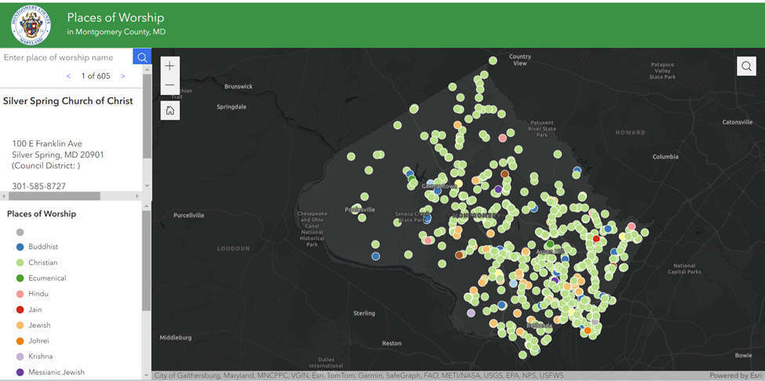
Places of Worship
Source: Faith Community Advisory Group

Slide 3
Spiritual Aspect of Palliative Care: for Providers
The National Consensus Project (NCP) Clinical Practice Guidelines for Quality Palliative Care identifies Spiritual, Religious, and Existential Aspects of Care as one of the 8 domains of care for those with serious illness or facing end of life.
The “gold standard” interdisciplinary palliative care team consists of doctors, nurses, social workers, chaplains and other disciplines who work together with a patient’s other doctors and community service providers to provide an extra layer of support.
Connecting to community can supplement Palliative Care spiritual support, including cultural competence.
National Consensus Project (NCP) Clinical Practice Guidelines for Quality Palliative Care
Notes:
Split into 2: for providers and for community

Slide 4
Spiritual Aspect of Palliative Care: for Community
For people of faith, advance care planning can be simultaneously a theological, medical, and legal process.
Some faith communities can clarify how end-of-life decisions align with spiritual beliefs and practices.
Many (non-medical) social and community supports are programs based out of local faith communities (i.e. Meals on Wheels, Rebuilding Together).
Pew Charitable Trust
Notes:
Split into 2: for providers and for community

Slide 5
Advance Care Planning: Key Findings
MDOH 11.18
Advance care planning is relevant and important to faith groups
Faith leaders serve as trusted and credible messengers
Faith groups are receptive to electronic advance directives
Advance care planning involves spiritual, medical, and legal considerations
Advance care planning is a process, not a checklist item

Slide 6
Caregivers
Faith based organizations have a meaningful role in the spiritual and emotional wellbeing of the individuals within their congregations and communities. ie:
Create or expand “family ministries” to include family caregiving as a special focus.
Hold special “caregiver outreach and recognition days” for their congregants at which local service providers can provide information about available services and supports.

Slide 7
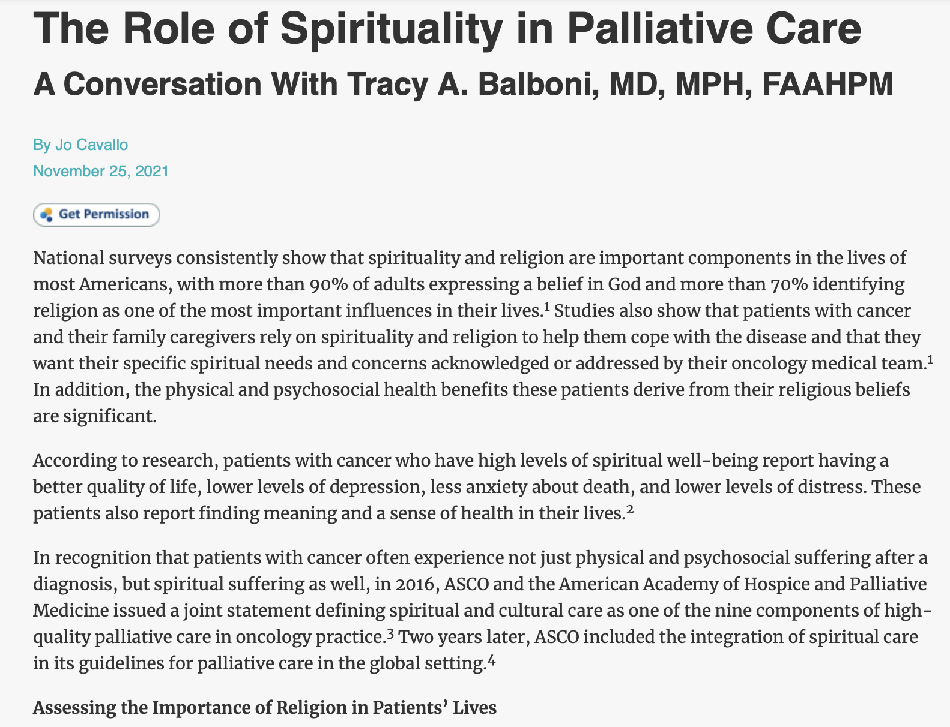
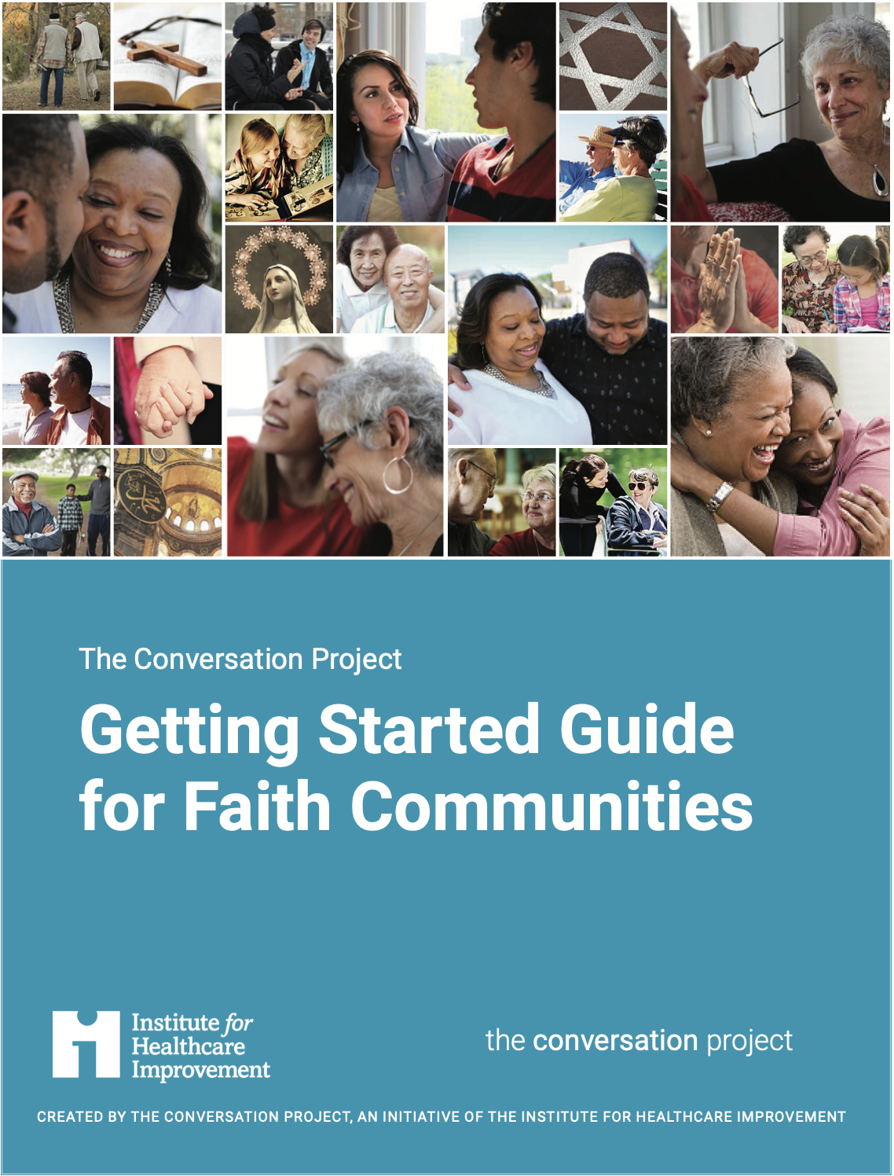
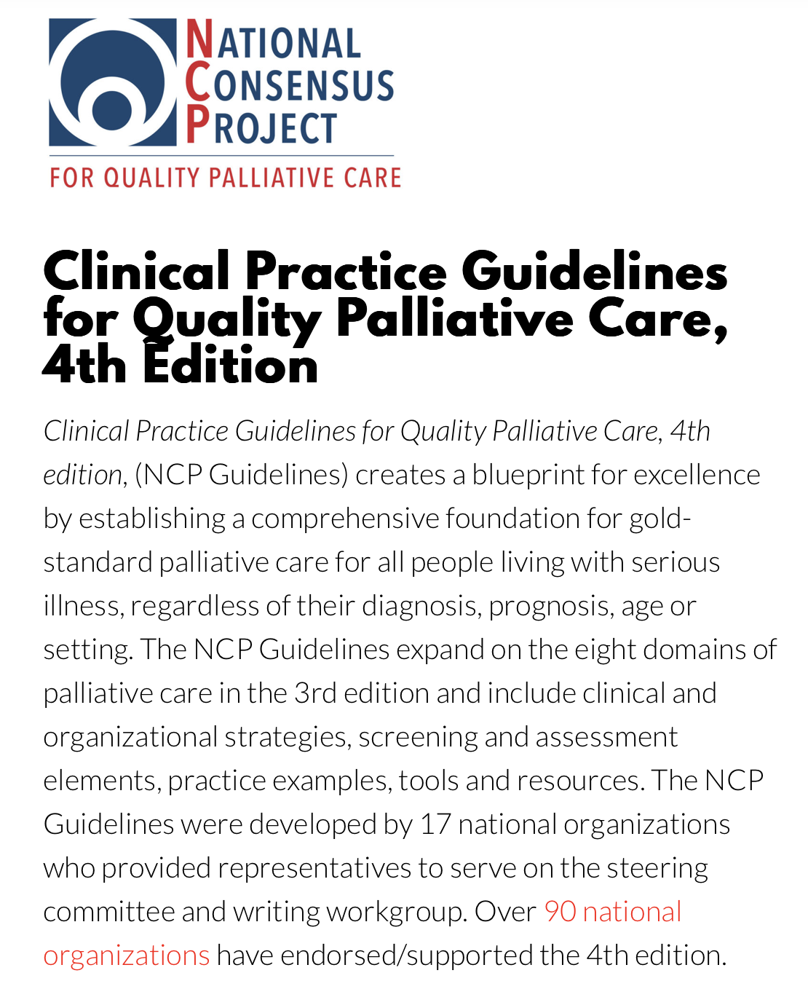
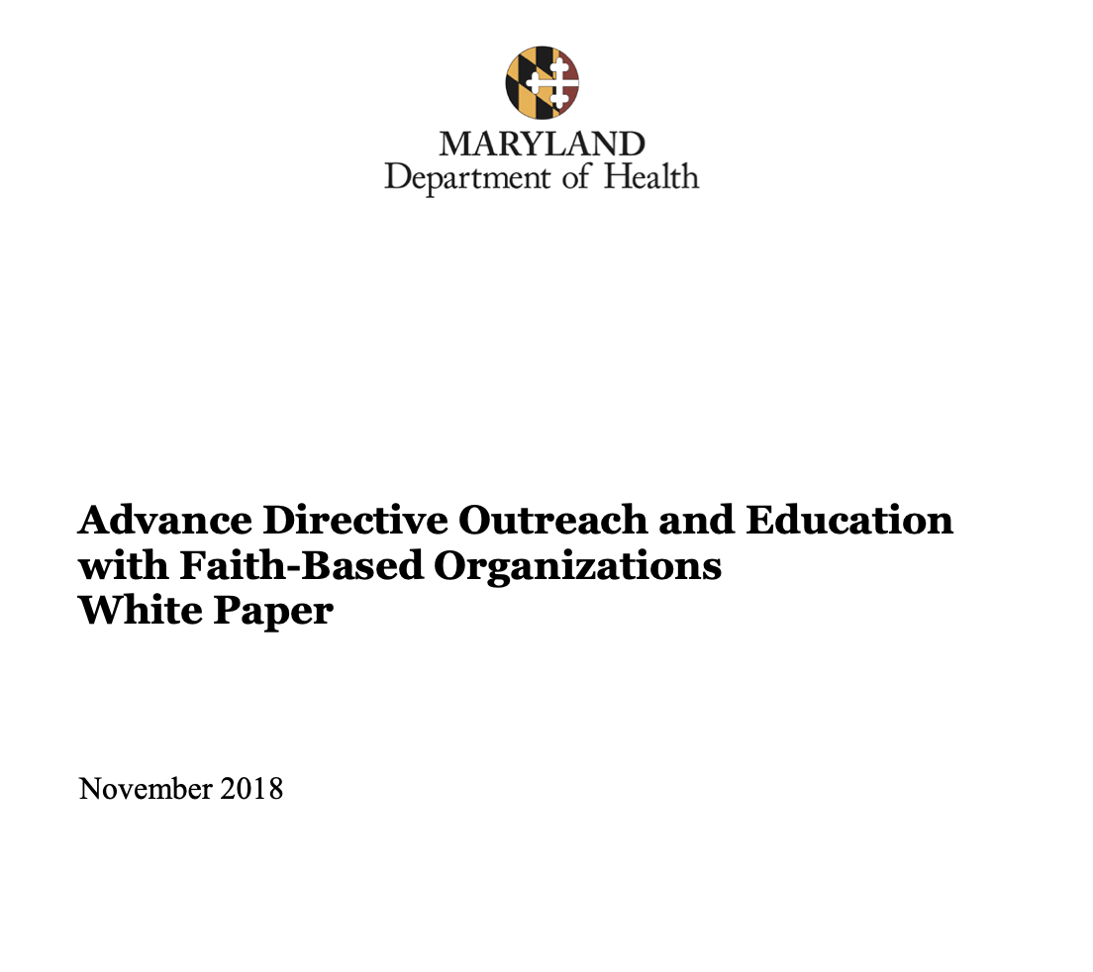
Resources

Slide 8
Presenters
Rev. Brandon Brewer, Director of Adult Bereavement Services, CaringMatters
Kate Chance, Community Faith Liaison, Montgomery County
Roslyn Roberts, Director of Faith and Community Partnerships, Interfaith Works

Slide 9
Connecting with the Local Faith Community to Support the Spiritual Aspect of Palliative Care
March 19, 2024
Visit us on our website: Montgomery County Palliative Care and End of Life Coalition or Contact us: mcpcelc@gmail.com

