Slide 1
End-of-Life Considerations Among Asian American Communities
Huixing （Kate）Lu, LCSW-C
Chinese Culture and Community Services, Inc. (CCACC)
240-271-0398
Kate.lu@ccacc-dc.org

Slide 2
CCACC was established in 1982;
CCACC is a non-profit, non-political, non-religious grassroots organization, and we have been serving as a focal point of the Chinese American community as well as a bridge to government services, cultural exchanges, and assimilation;
There are more than 1,500 members, directly serve 5000 , hundreds of volunteers and nearly 300 employees;
Our Services cover the age from 2 to 105 years old for over 100,000 people (services/encounters) yearly;
Our annual operating budget is over $15 million.

Slide 3
CCACC Services
ADHC
Home Care
Art Gallery
Health Center
Sports
Academy
Community Services

Slide 4
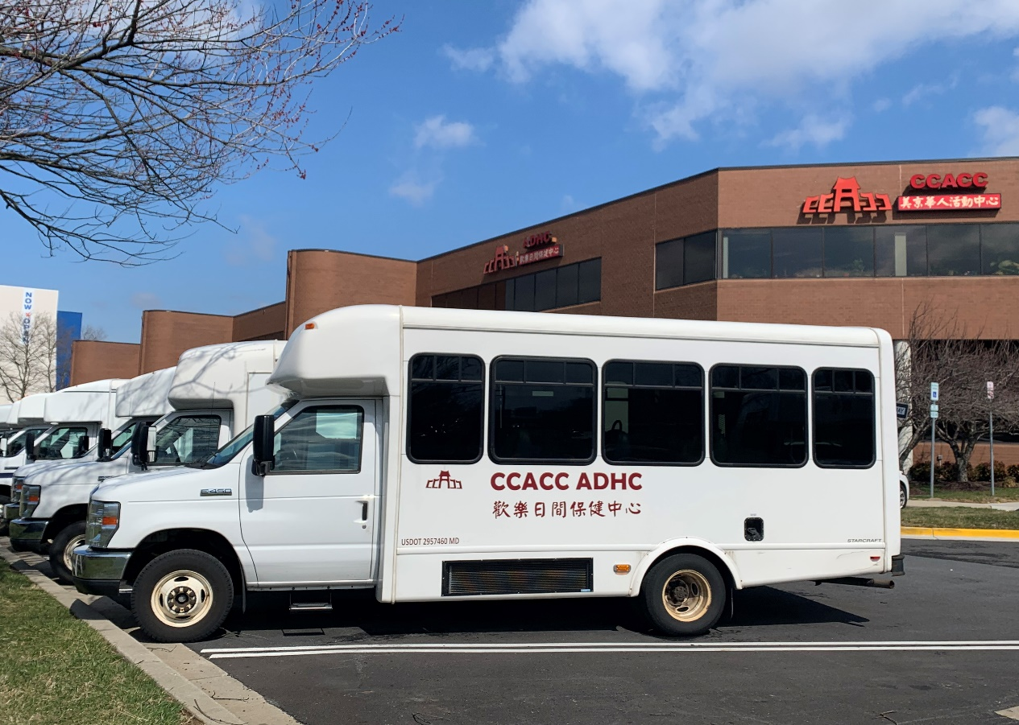
Adult Day Healthcare Center
Since 2008
The only non-profit Adult Day Healthcare Center in Chinese community in Maryland
Open 7 days a week
Serves about 200 seniors daily

Slide 5
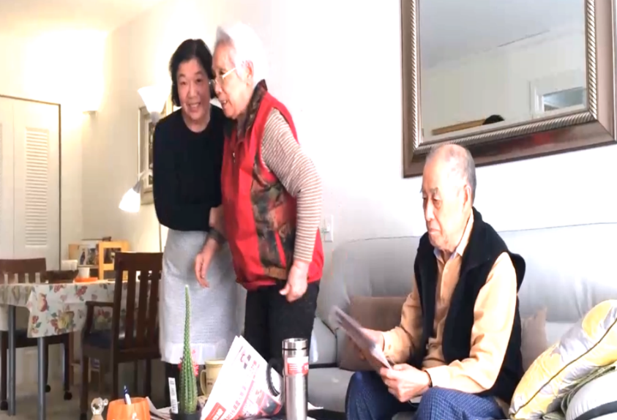
CCACC Home Care
Since 2015
Home Care Services
Bathing and Dressing
Companionship
Feeding
Grocery shopping
Grooming and Hygiene
Laundry
Light Housekeeping
Meal Preparation
Medication reminders
Toileting

Slide 6
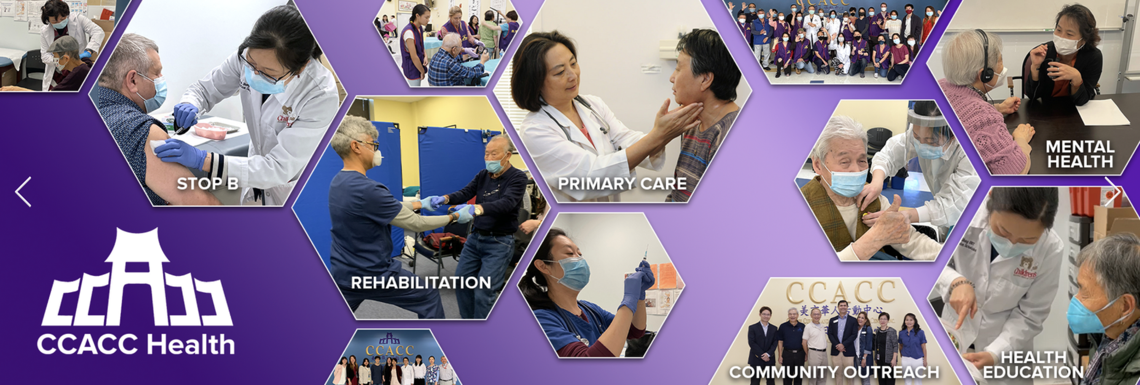
CCACC Health Center/PAVHC since 2003 ONE-STOP COMMUNITY HEALTH CLINIC

Slide 7
Asian American Populations in Montgomery County

Slide 8
End of Life Issues Considerations
Cultural and Religious Diversity:
Asian Americans encompass a wide range of cultural and religious backgrounds
Each culture may have unique traditions, rituals, and beliefs related to death and dying.
Familial Roles:
Family is often central in many Asian cultures,
Decisions regarding end-of-life care and funeral arrangements may involve close family members.
Respect for elders and adherence to family traditions can be significant aspects of this process.

Slide 9
End of Life Considerations
Language Barriers:
In Montgomery County, 69.8% of Asian Americans were born outside the US.
Language can play a crucial role in end-of-life discussions and decisions.
Limited English proficiency may present challenges in communicating preferences for care and understanding medical information.
Healthcare Decision-Making:
Navigating the healthcare system, understanding medical terminology, and making informed decisions about end-of-life care.
Cultural competence among healthcare providers is important in providing appropriate and sensitive care.

Slide 10
End of Life Considerations
Acculturation:
The level of acculturation (adoption of the host culture's customs and values) within the Asian American community can influence how individuals approach end-of-life issues.
Some may prefer to adhere strictly to their cultural traditions, while others may adopt more Westernized practices.
Community Resources:
Access to community resources, support groups, and culturally sensitive hospice or palliative care services can impact the end-of-life experience for Asian Americans.
Approach with cultural sensitivity and respect for individual preferences.
open communication can contribute to more positive end-of-life experiences.

Slide 11
My Personal Journey
Ongoing conversations
Mutual understanding among family members
Love is the prescription

Slide 12
Addressing Advance Care Planning
Ensuring individual preferences are respected.
Initiate conversations about end-of-life preferences within families:
start early, and keep consistent
Follow up conversation
Primary Care Providers initiate/lead the conversation
Encourage ongoing dialogue, education, and cultural sensitivity in addressing end-of-life issues within the Asian American community.

